Slide 1
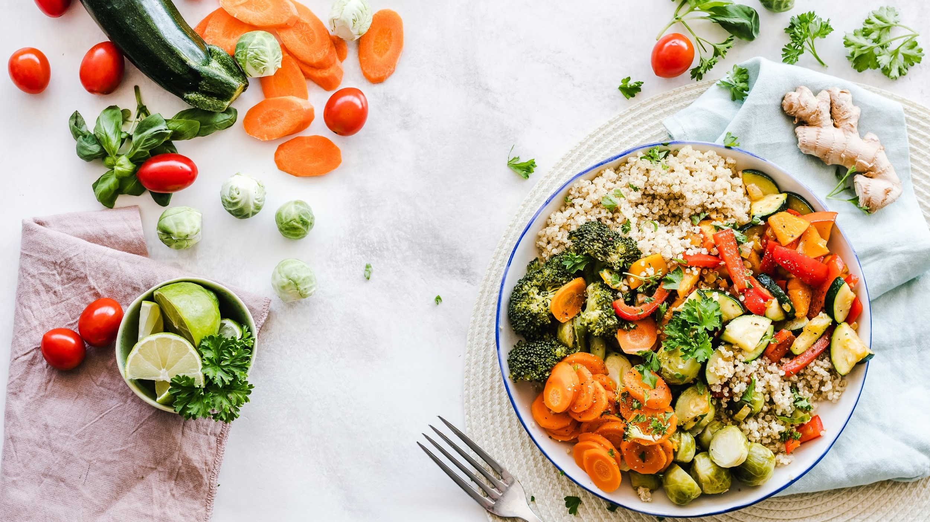

E-CUISINE
GROUP NO. 5
FOOD LOVE
SUBMITTED TO : MOHAMED ZEROUG
SUBMITTED BY : Akanksha ,
Akhilesh,
Abhinav,
Sarinderpal Singh
PRESENTATION
Brought to you by: https://GoogleSlidesThemes.com

Slide 2
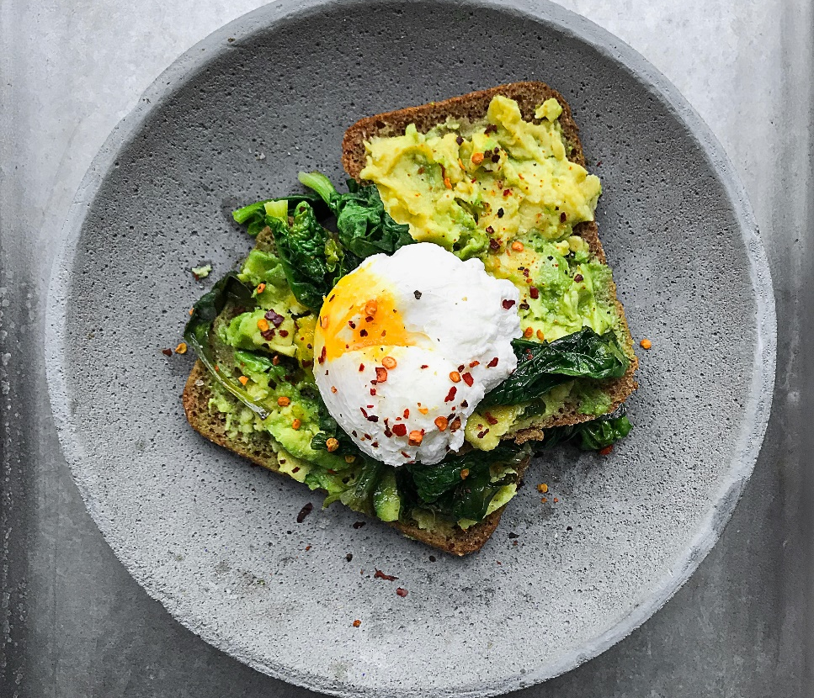
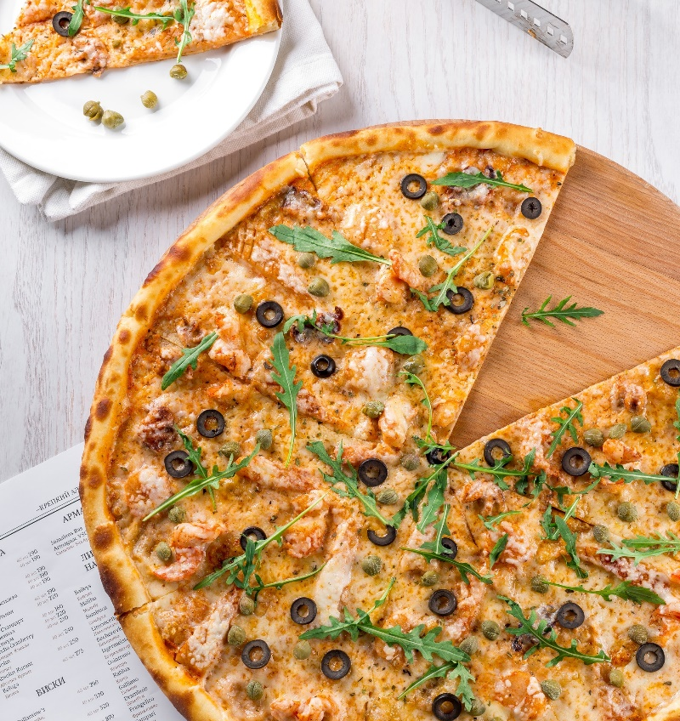
ABOUT US
E-Cuisine app provides a wide range of advantages like whether on a break, stuck in traffic or riding the bus, virtually anyone can place an order quickly and painlessly.
With online food ordering app, all preferences are specified directly by the customer, so there is no room for confusions or misunderstandings. It’s a service which is open to its customer 24*7. By using an online food ordering system, you can give your clients the flexibility to place the orders whenever it’s most convenient for them.
Switching the focus from offline ordering to online ordering means less hassle of handling undecided calling clients and the staff time lost in the process and that means significant money savings for the customers.
Food
Drink
Meat
FOOD LOVE

Slide 3
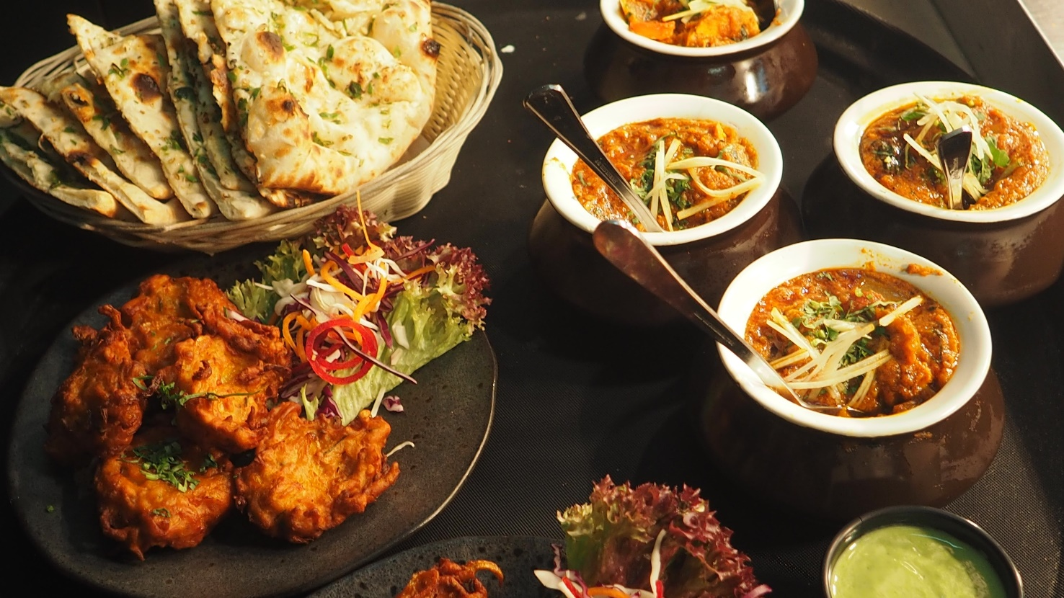
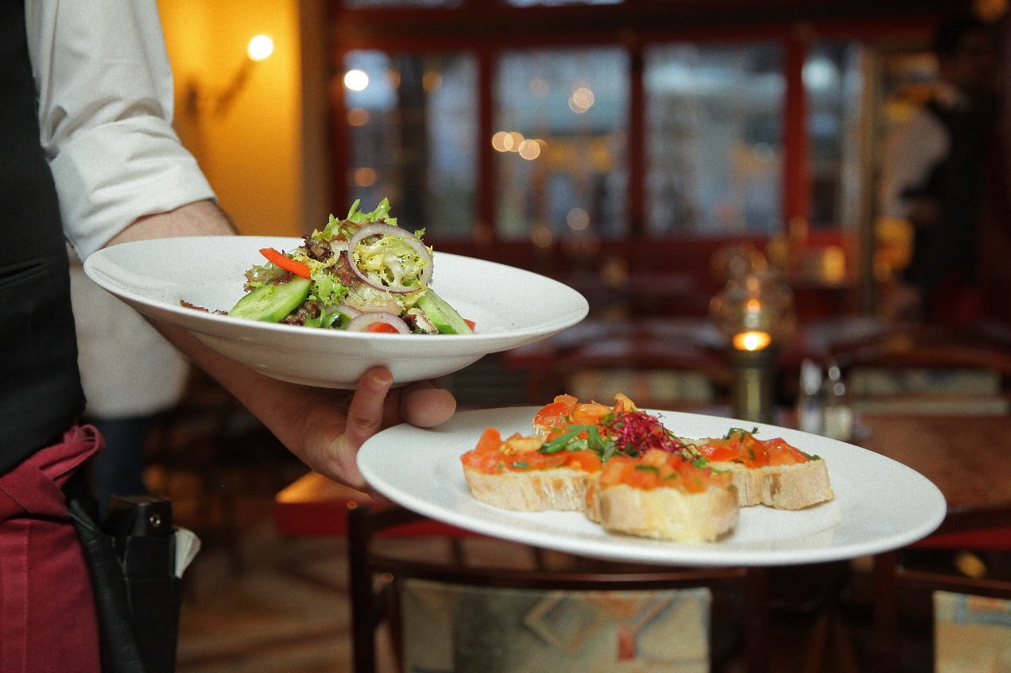
FEATURES
AND ITS USER STORIES
FOOD LOVE
3
VIEW AND PLACE ORDER
PAYMENT INTEGRATION
SUBMIT ORDER
VIEW ORDER HISTORY
1
4
MANAGE END USERS
SIGN IN USER
SIGN UP USER
REMEMBER USER
LOGOUT
GO TO DASHBOARD/MENU
2
MANAGE FOOD MENU
VIEW MENU CATEGORIES
VIEW FOOD
VIEW FOOD DETAILS
MONITOR CART DATA FOR EACH USER
VIEW CART
ADD TO CART
UPDATE CART
DELETE CART
QUICK CART
.
5
6
7
MANAGE ADMIN
ADMIN SIGN IN
WELCOME PAGE/DASHBOARD
8
MENU MANAGEMENT
ADD CATEGORY
ADD FOOD
SHARE TO FACEBOOK
FOOD SHARE
MANAGE FAVOURITES
ADD TO FAVOURITES
REMOVE FROM FAVOURITES

Slide 4

GOAL OF THIS SPRINT
TO COMPLETE WHOLE PROJECT WITH PRE-PLANNED USER STORIES.
TO COMPLETE ADMIN SIDE
COMPLETE PROJECT WITH IMPROVEMENTS FROM LAST SPRINT
ACHIEVE PROJECT COMPLETION WITHOUT ANY OBSTACLE
FOOD LOVE

Slide 5
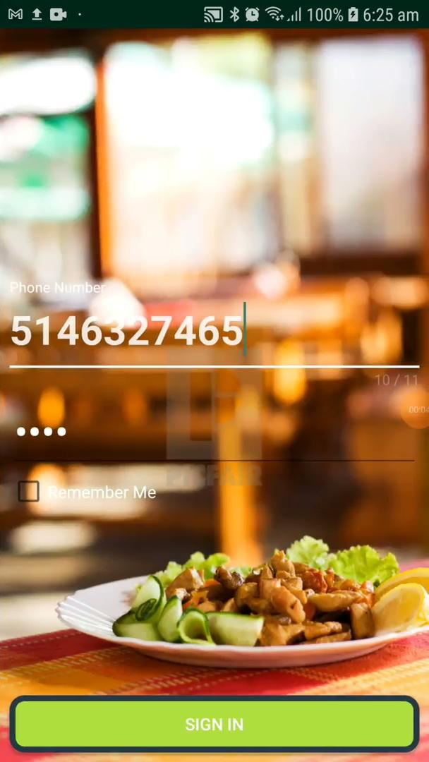
FINAL SPRINT USER STORIES
As a User :
I want to REMEMBER TO APP so that i don’t have to Login to App over and over.
Given
I am On Sign In
When
I click on Remember User CheckBox
Then
I am remembered to app and not have to login again
FOOD LOVE

Slide 6
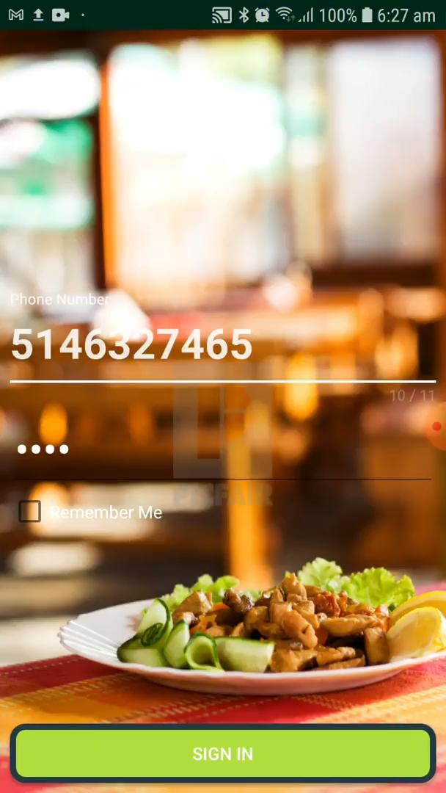
FINAL SPRINT USER STORIES
As a User :
I want to LOGOUT from app so that i no longer remembered on app
Given
I am On my Dashboard/Menu
When
I open drawer and click on Sign out
Then
I am no longer remembered to app and have to login again to app.
FOOD LOVE

Slide 7
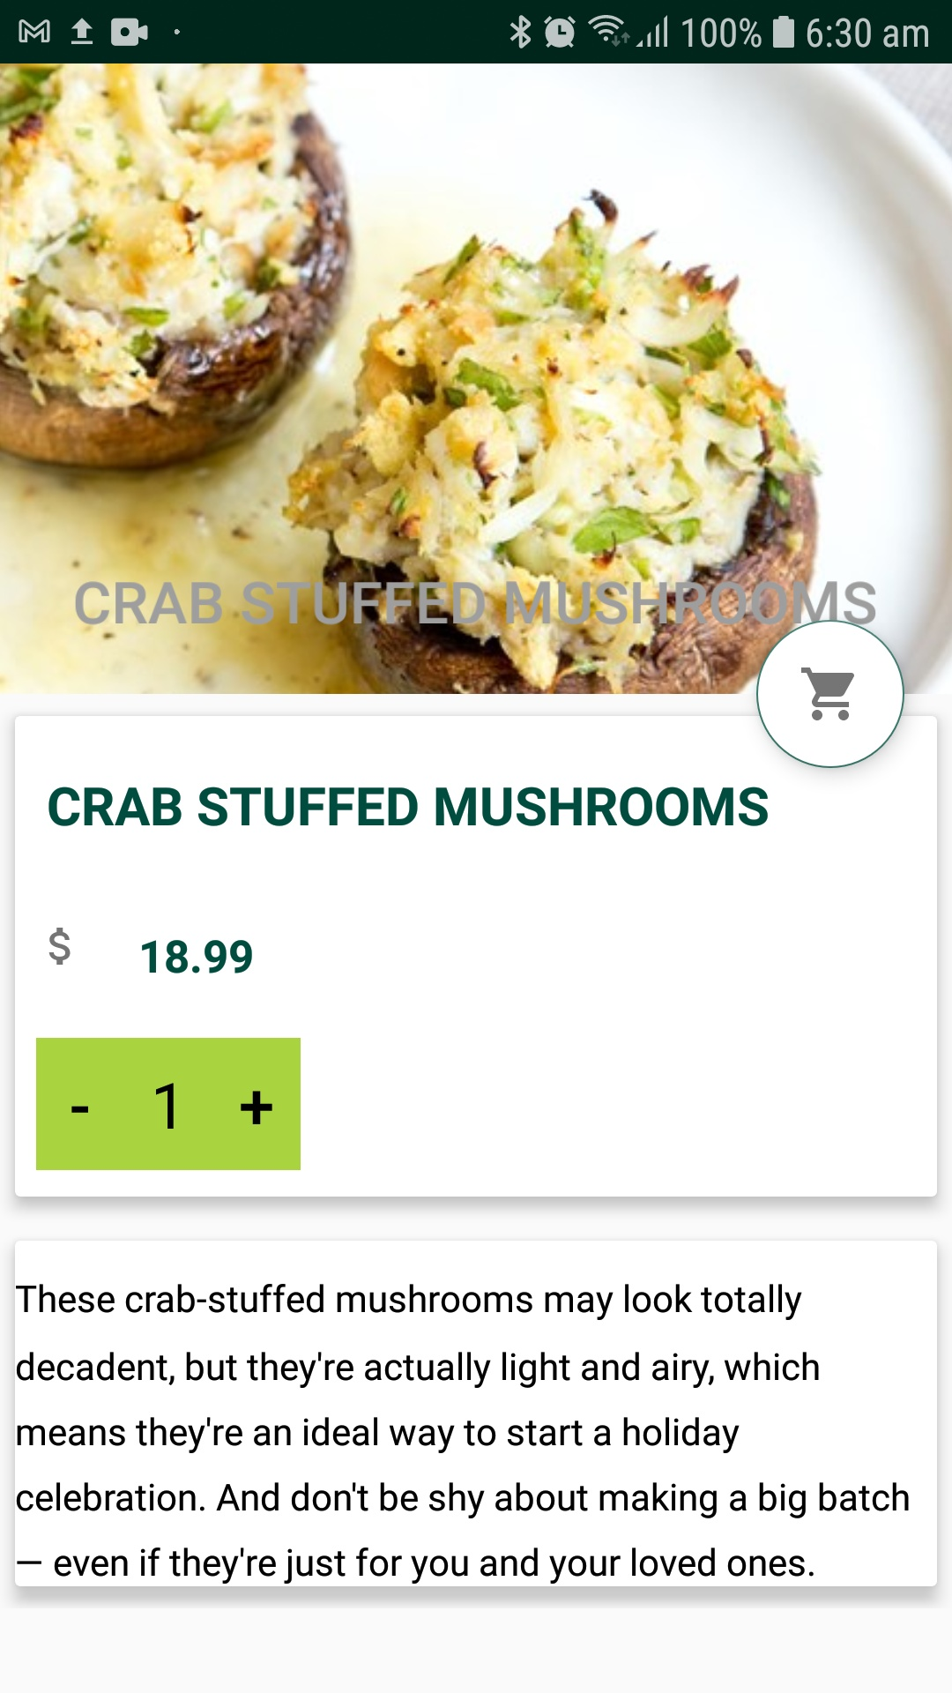
FINAL SPRINT USER STORIES
As a User :
I want to see details of food so that i can see their price description.
Given
I am On my Menu and click on particular food category
When
I click on particular food item
Then
I can see details of food with price and description.
FOOD LOVE

Slide 8
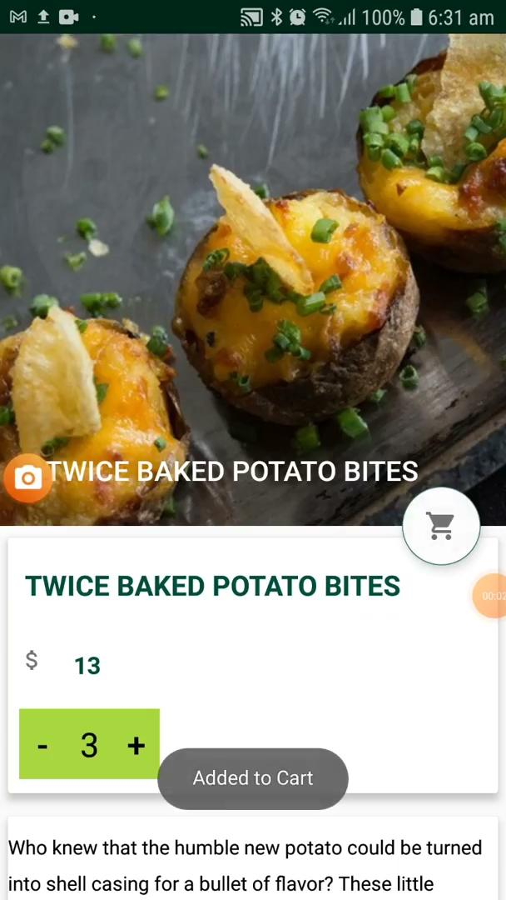
FINAL SPRINT USER STORIES
As a User :
I want to save food items with particular quantity to cart so that i can place my order.
Given
I am On my food details
When
I click on cart icon and change quantity
Then
food item is added to cart
FOOD LOVE

Slide 9
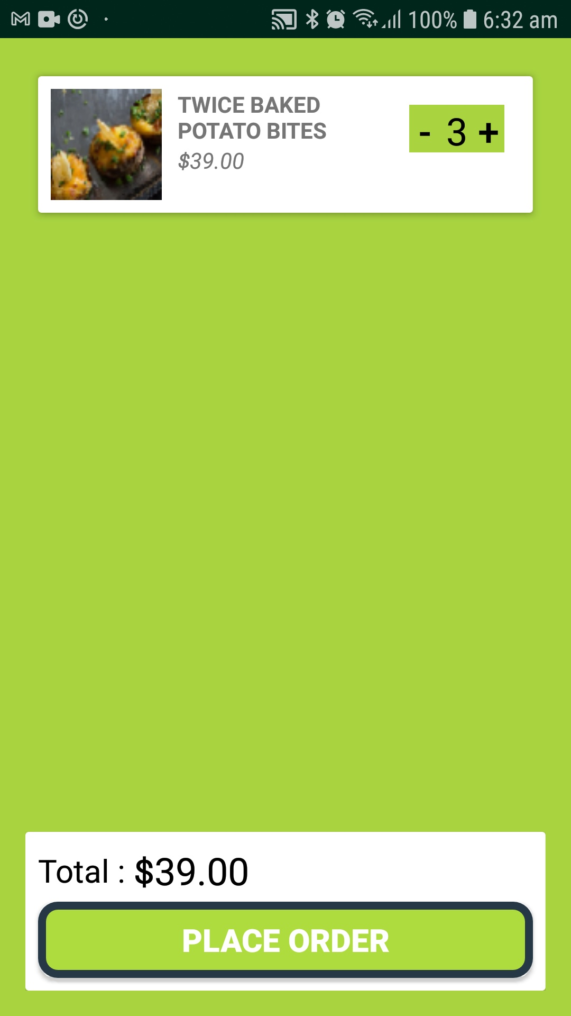
FINAL SPRINT USER STORIES
As a User :
I want to view my cart so that i can place my order
Given
I am On my menu page
When
I click on floating cart icon
Then
i can see my food items in my cart.
FOOD LOVE

Slide 10
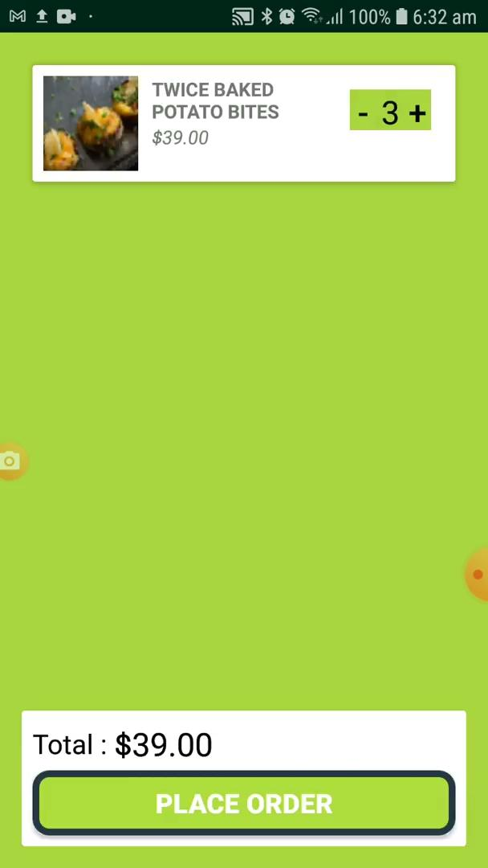
FINAL SPRINT USER STORIES
As a User :
I want to delete items from my cart so that i can remove items which i dont want to order
Given
I am Cart Page
When
i swipe the food item to Left
Then
i can delete food item from my cart.
FOOD LOVE

Slide 11
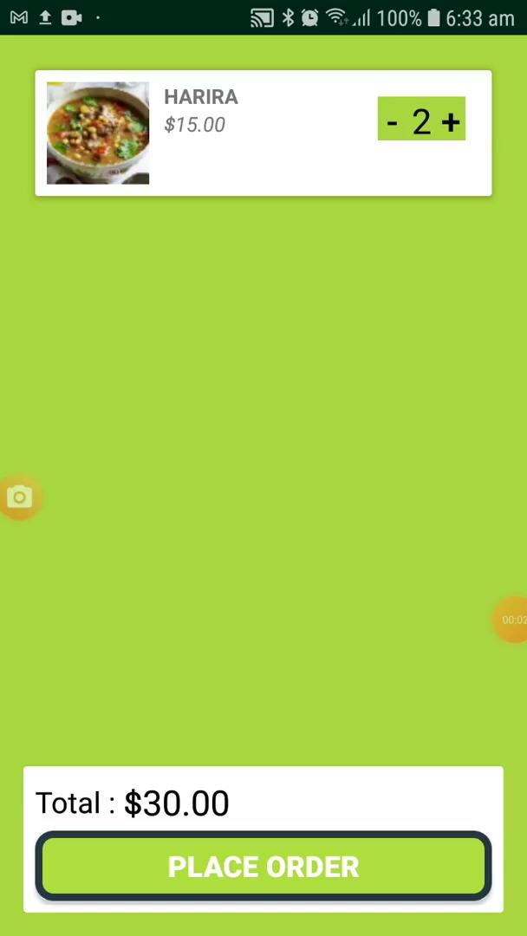
FINAL SPRINT USER STORIES
As a User :
I want to update cart so that i can decrease or increase quantity of particular food item
Given
I am Cart Page
When
i use elegant number button
Then
i can update quantity of food item.
FOOD LOVE

Slide 12
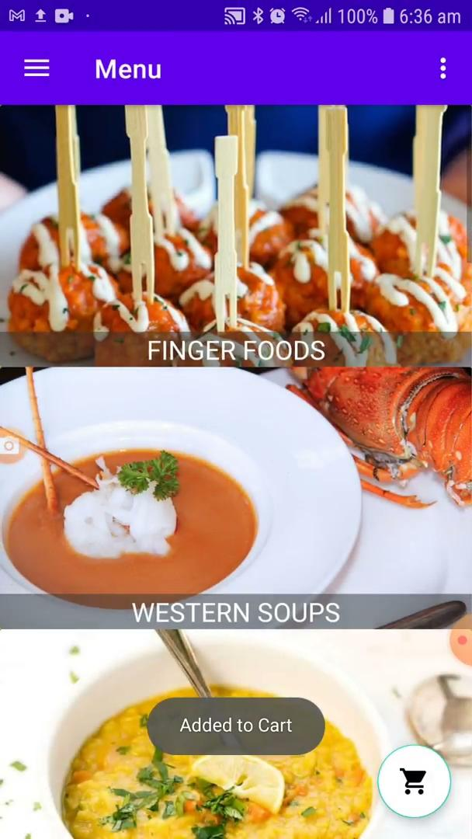
FINAL SPRINT USER STORIES
As a User :
I want to have quick cart so that i don’t have to food detail page to add to cart.
Given
I am on food List Page
When
i click on cart icon for each food item
Then
i can quickly add 1 selected item to my cart.
FOOD LOVE

Slide 13
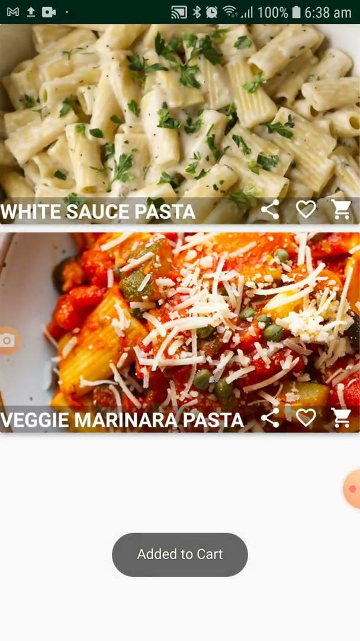
FINAL SPRINT USER STORIES
As a User :
I want to place order so that i can pay for my food
Given
I am Cart Page
When
i click on Place order button
Then
i can go to paypal payment .
FOOD LOVE

Slide 14
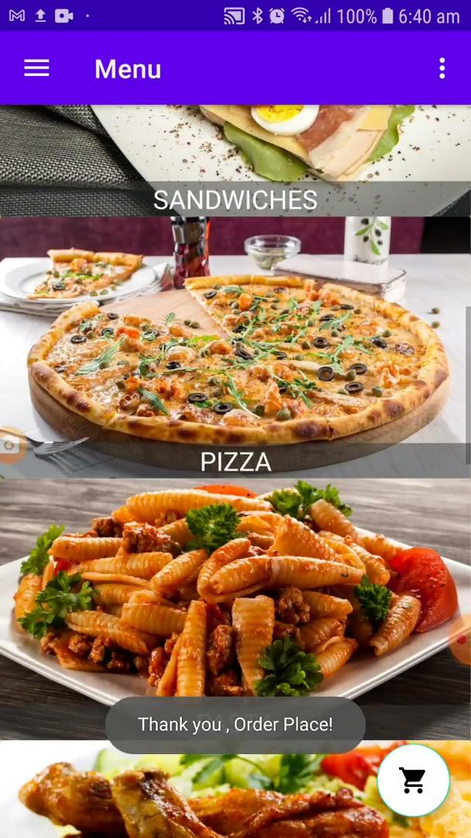
FINAL SPRINT USER STORIES
As a User :
I want to pay my food through paypal payment so that i can order my food without card details
Given
I click on place order button
When
i login to my authenticated paypal account and click on payment
Then
i my order is placed successfully.
FOOD LOVE

Slide 15
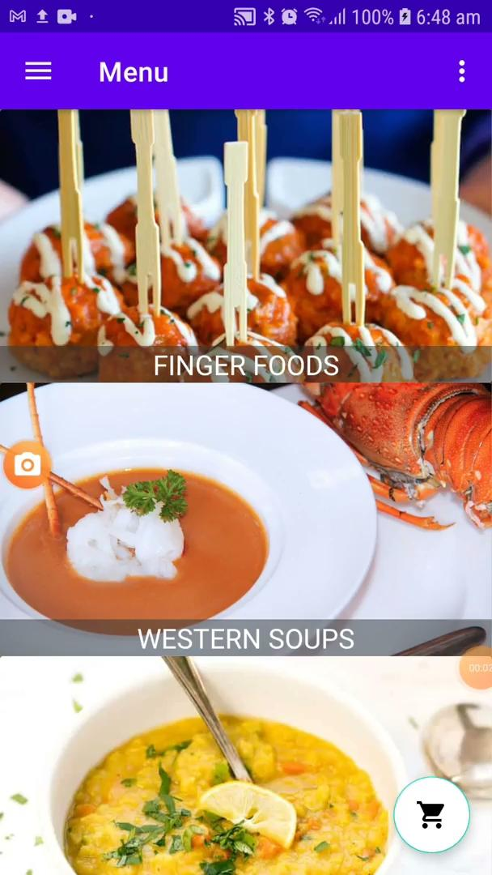
FINAL SPRINT USER STORIES
As a User :
I want to view my order history
so that i can keep track of all of my orders
Given
I am on my Dashboard
When
i open navigation drawer and click on order history menu
Then
i i can see my order history.
FOOD LOVE

Slide 16
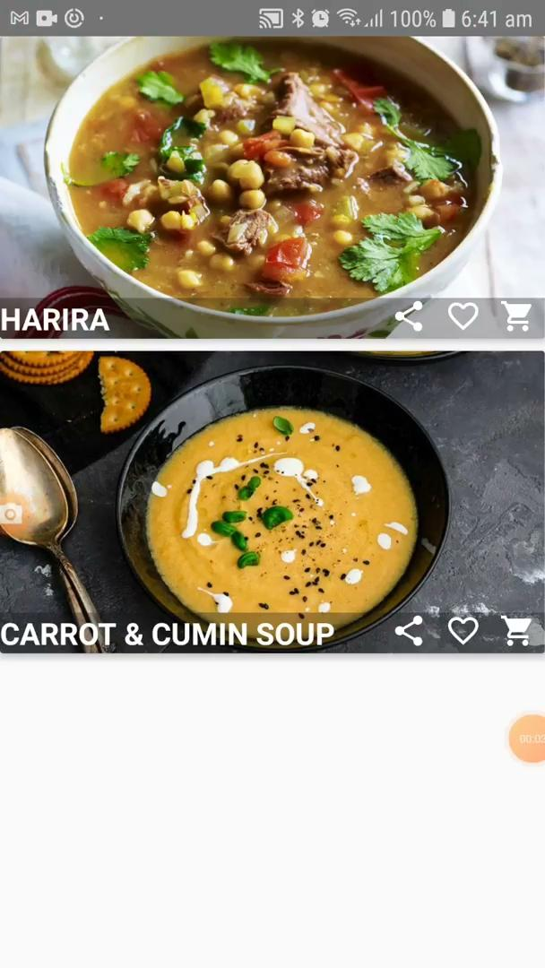
FINAL SPRINT USER STORIES
As a User :
I want to share the food i eat with other people so that i can promote the app and restaurant
Given
I am on food list page
When
i click on share button
Then
facebook share posting should be opened and can share post and tag anyone on my post.
FOOD LOVE

Slide 17
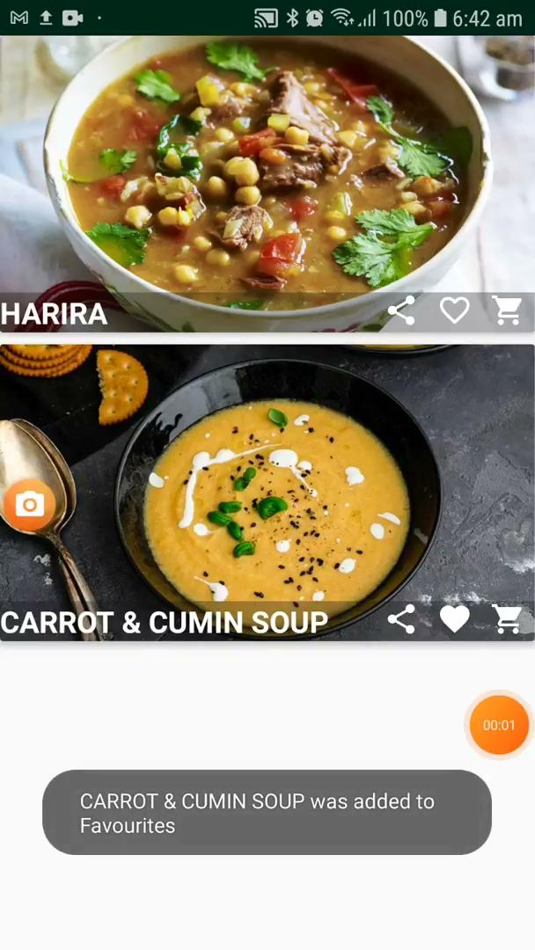
FINAL SPRINT USER STORIES
As a User :
I want to add or remove food item from my favorites so that i can save them for future.
Given
I am on food list page
When
i click on Favorites icon
Then
food item is saved or removed to and from my favorites.
FOOD LOVE

Slide 18
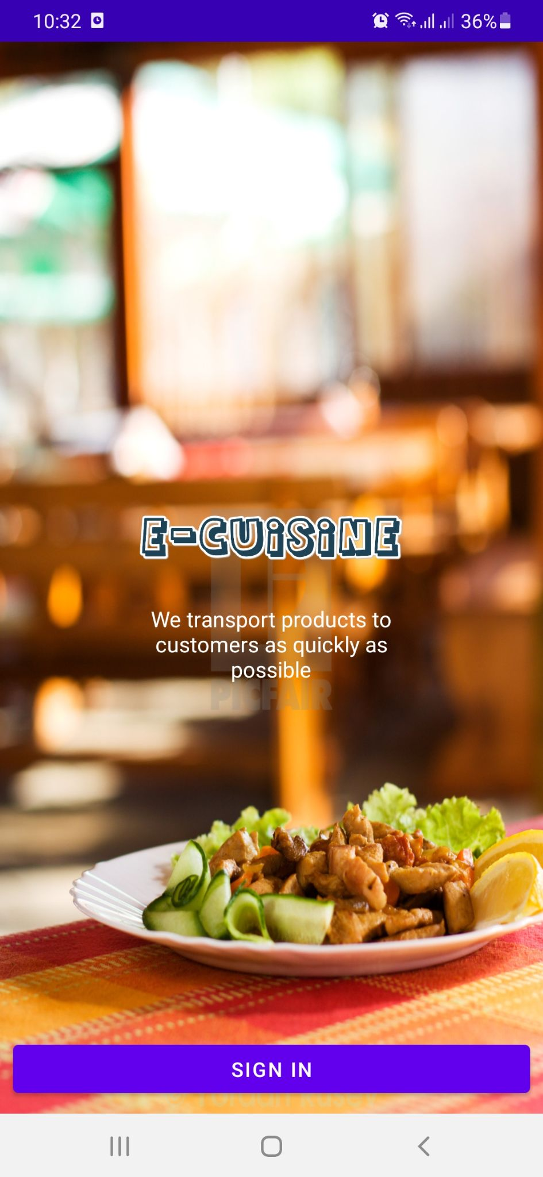
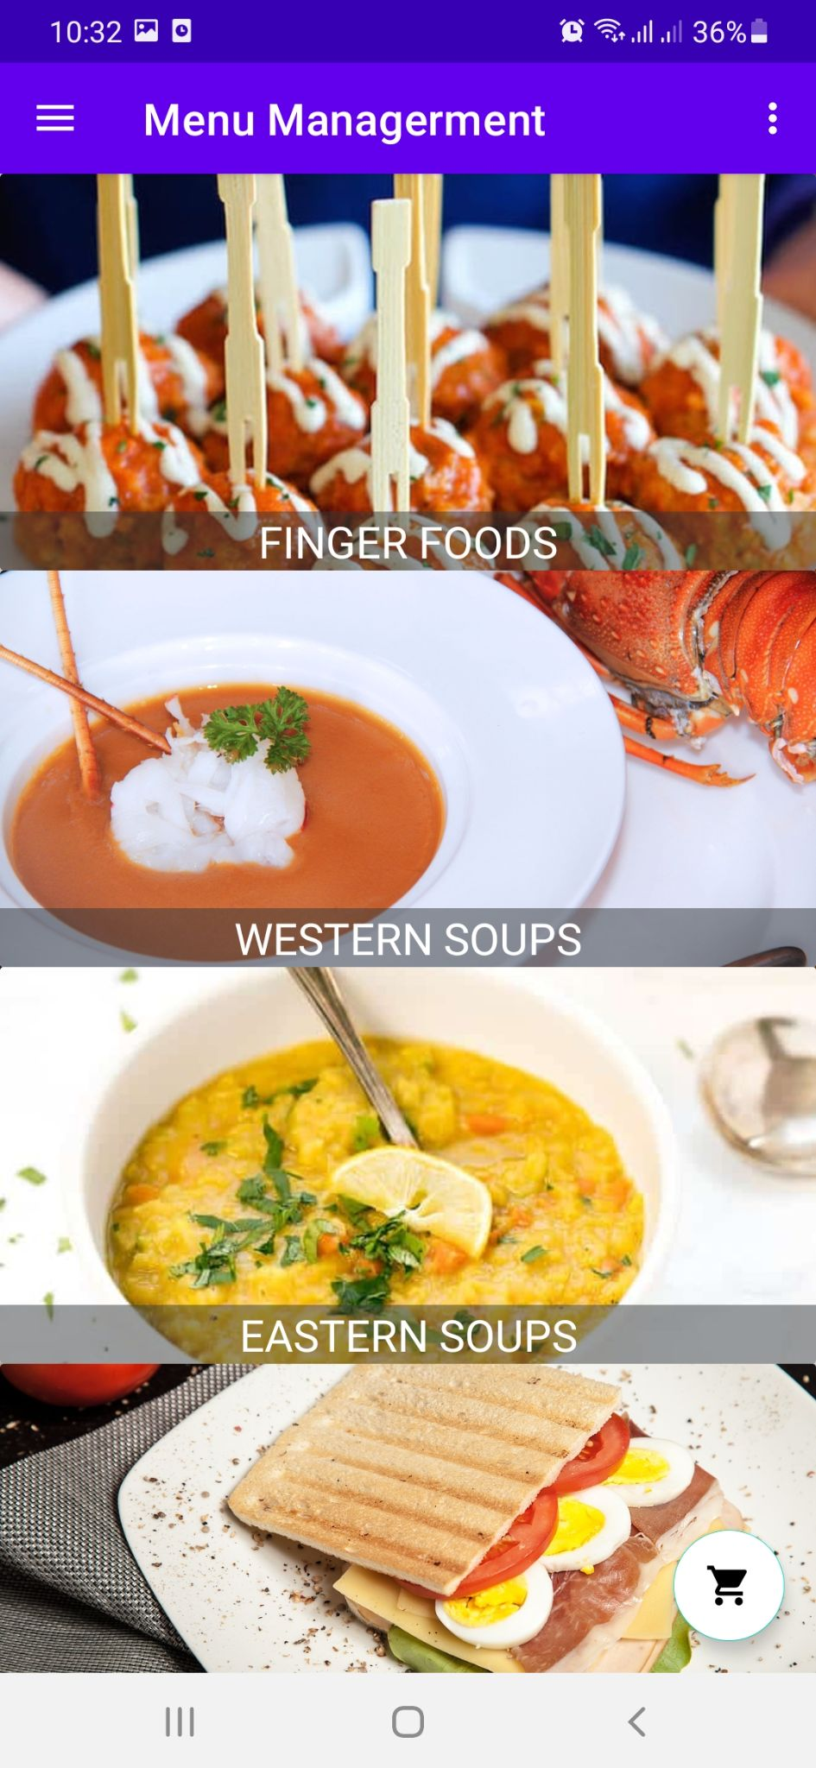
FINAL SPRINT ADMIN STORIES
As a ADMIN :
I want to sign in to the app so that i can go to my dashboard.
Given
I am on Sign in
When
i enter details and click sign in
Then
i can see my dashboard.
FOOD LOVE

Slide 19
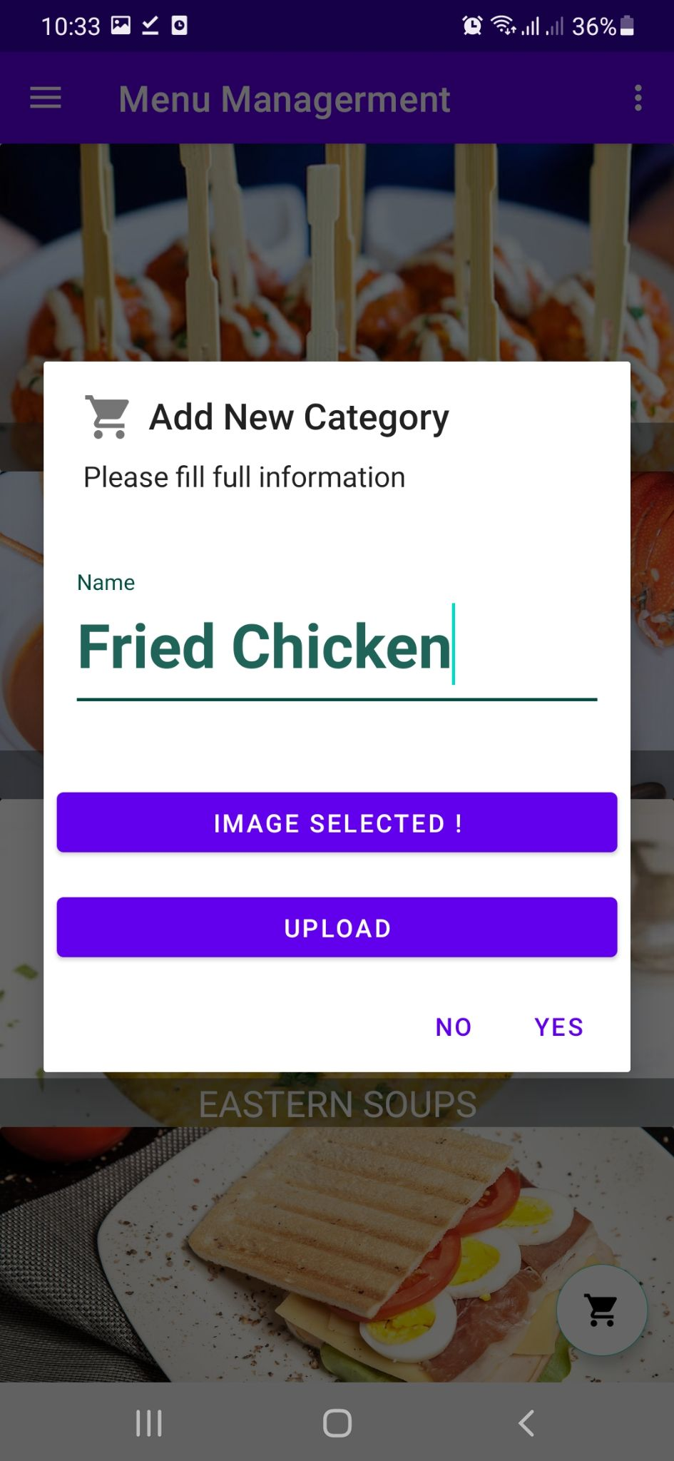
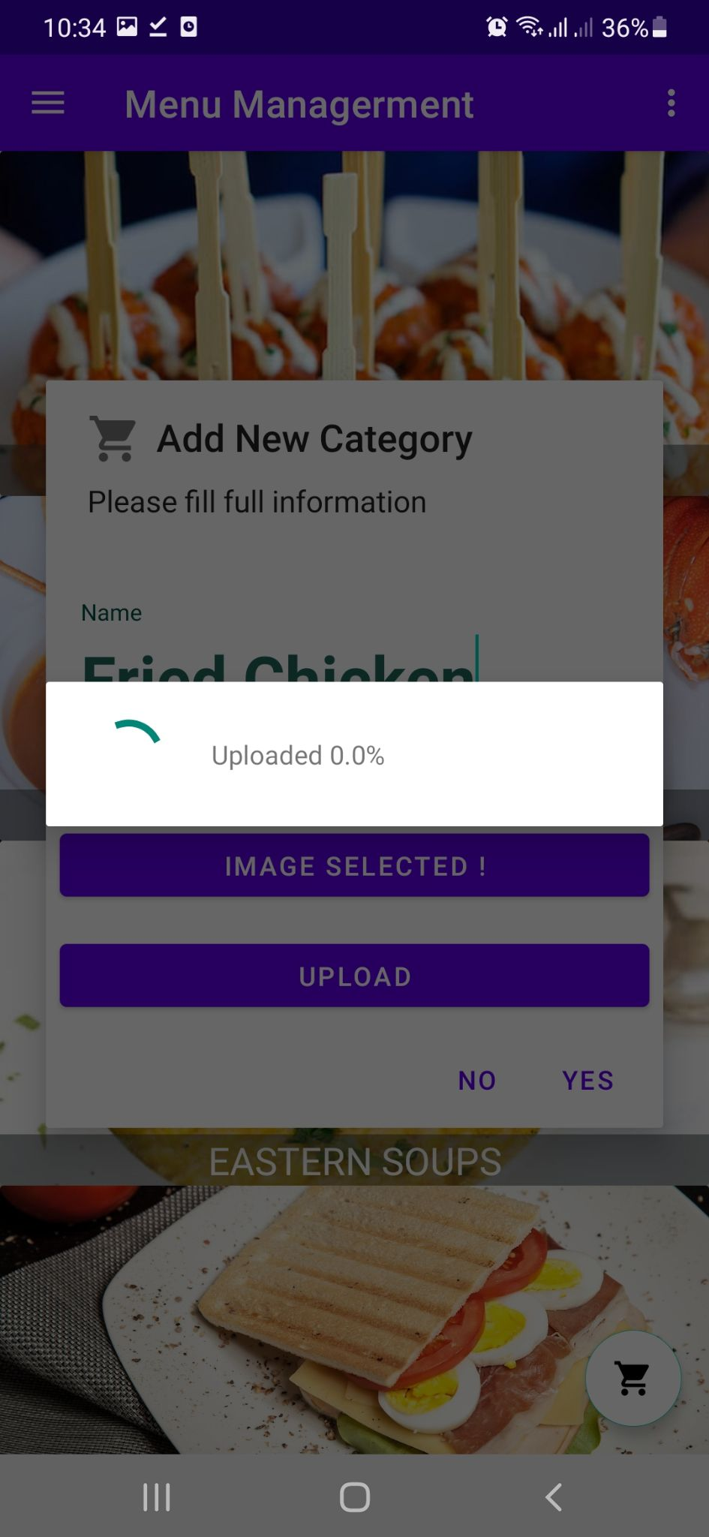
FINAL SPRINT ADMIN STORIES
As a ADMIN :
I want to add food category to my menu so that i can update my menu and more categorize them.
Given
I am on my Dashboard
When
i select add category icon
Then
i can add new category to my menu.
FOOD LOVE

Slide 20
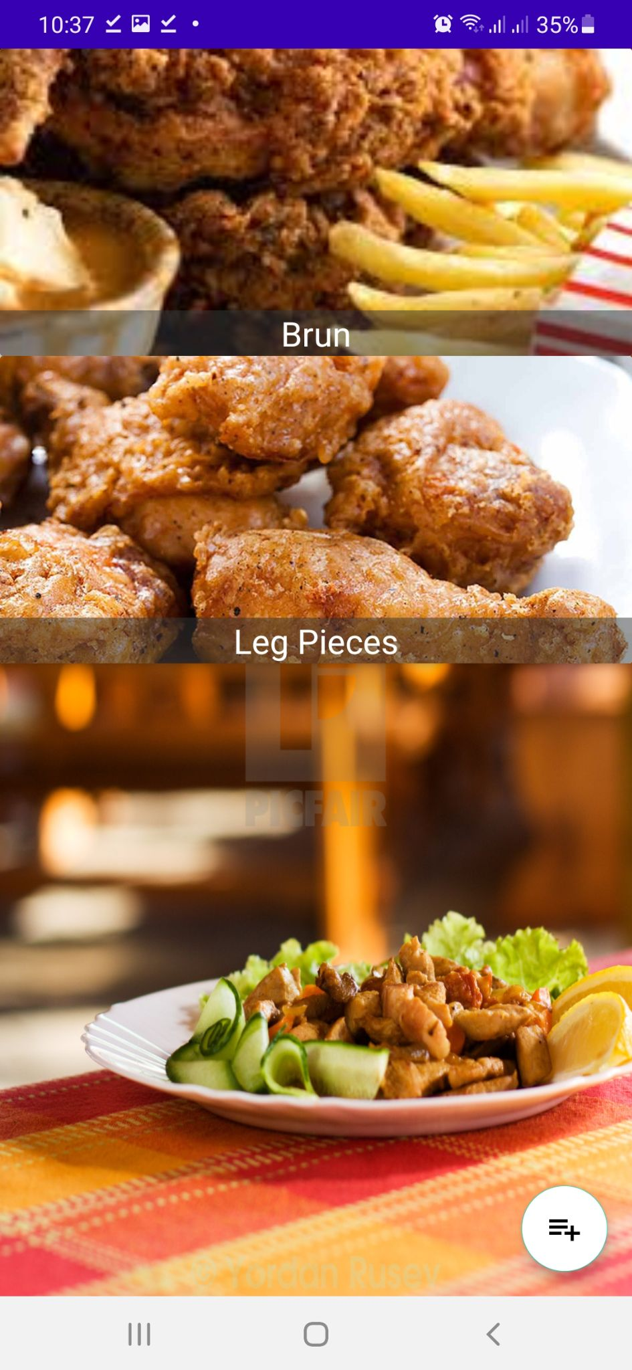
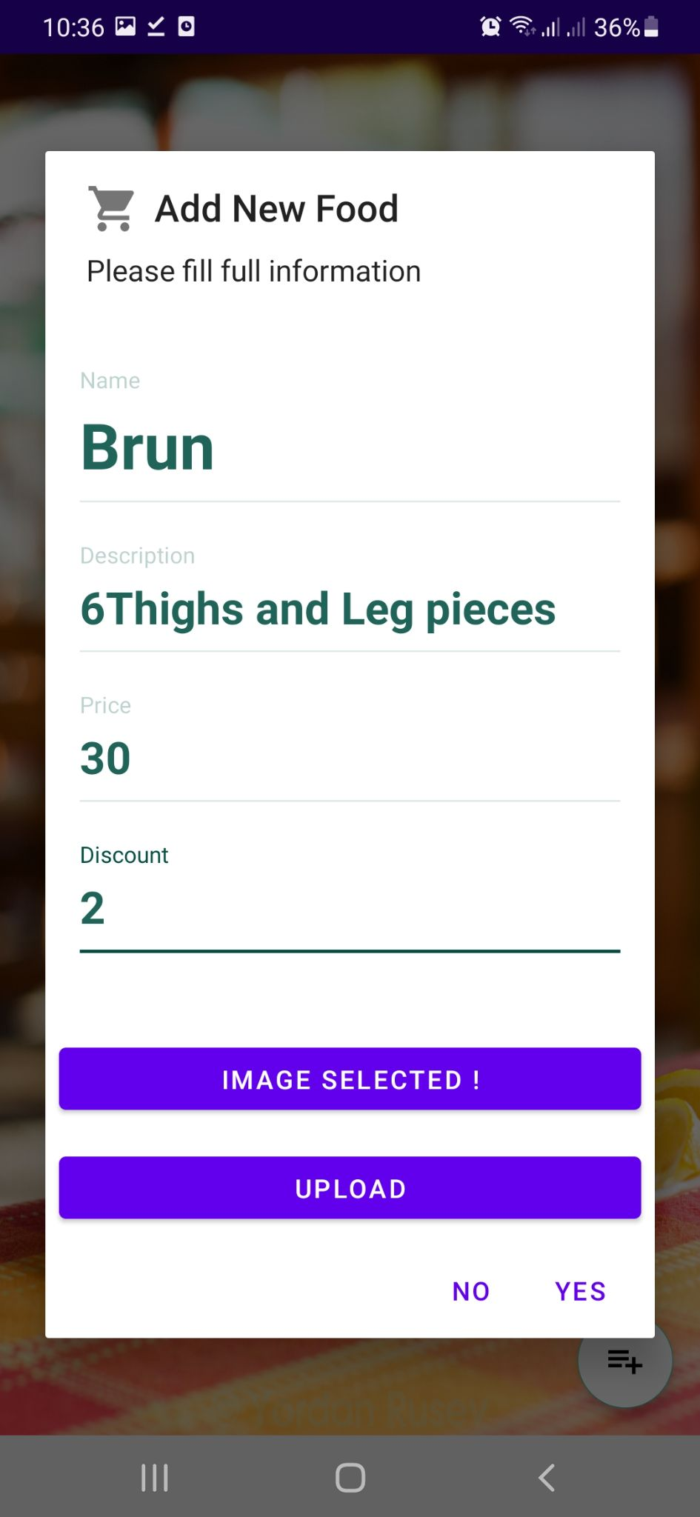
FINAL SPRINT ADMIN STORIES
As a ADMIN :
I want to food for particular category so that end user can see our new dishes.
Given
I am on my food category list
When
i select particular category and click add icon
Then
i can add new food item for menu and customers.
FOOD LOVE

Slide 21
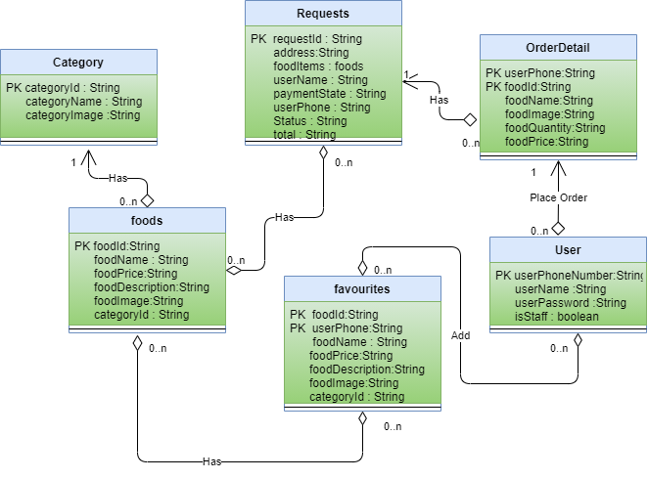
CLASS DIAGRAM
FOOD LOVE

Slide 22
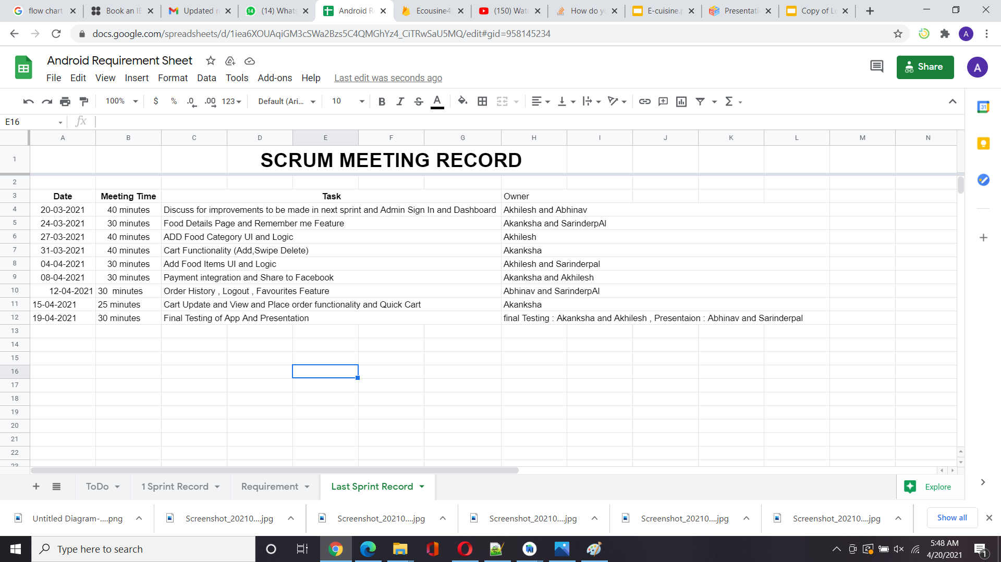
SCRUM MEETING RECORD
FOOD LOVE

Slide 23
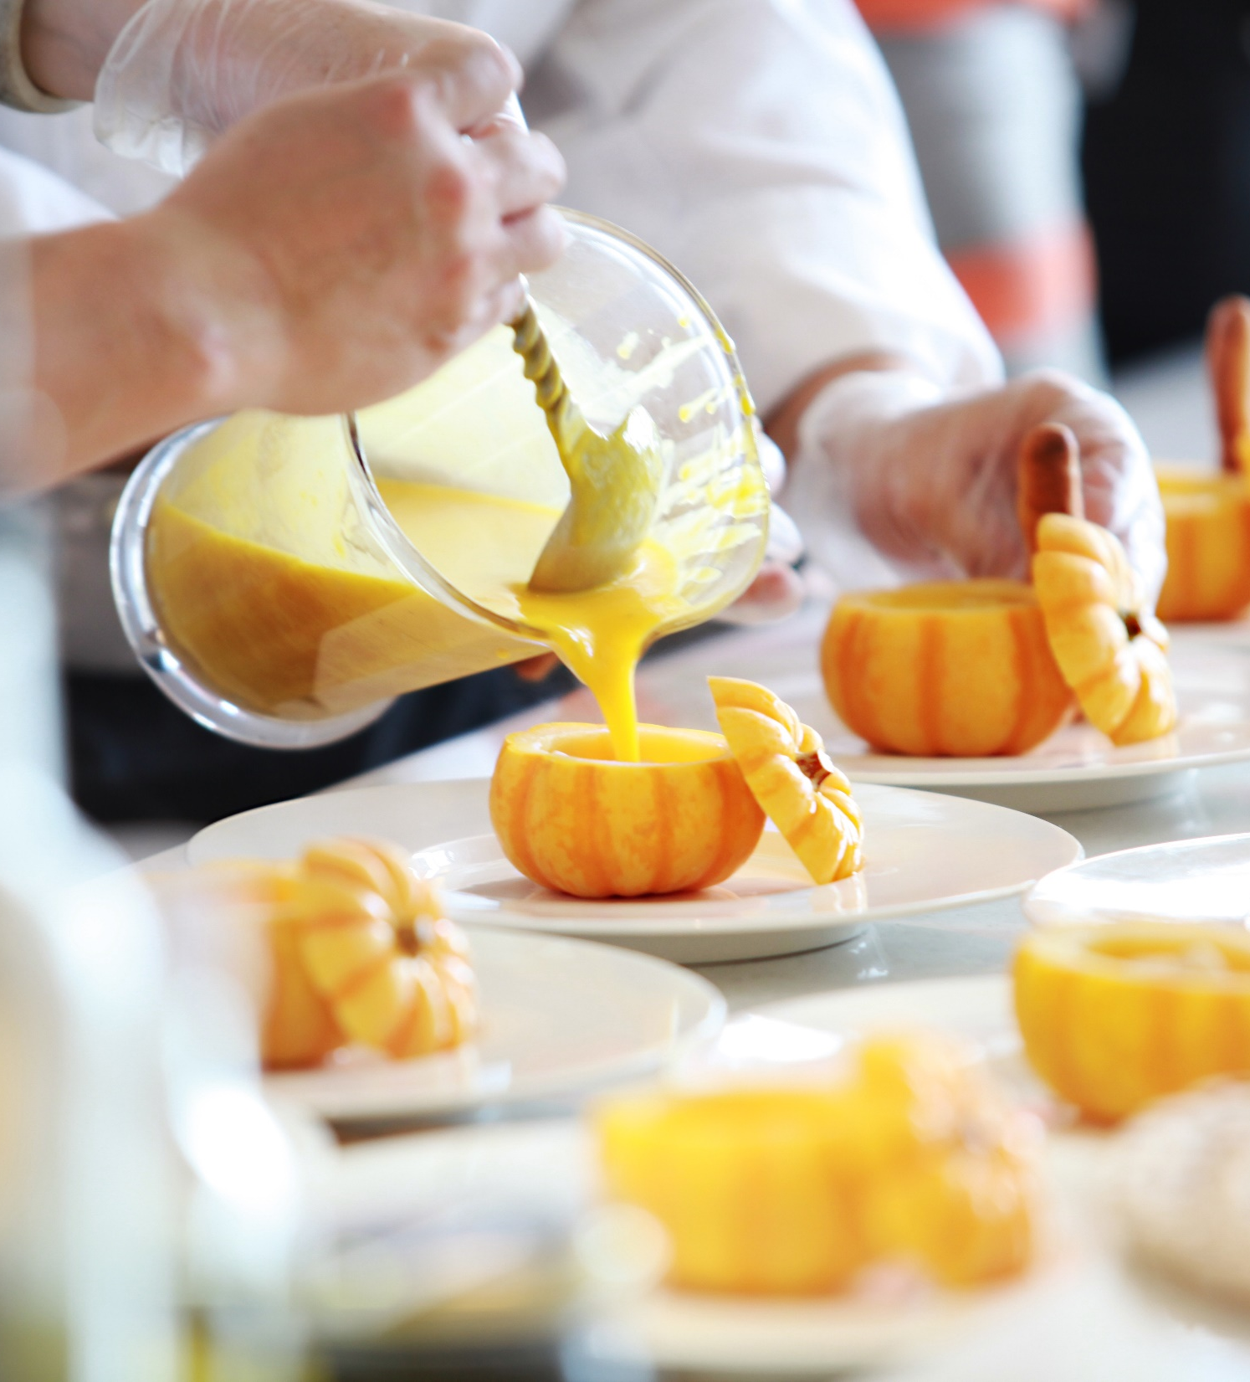
HOW OUR APP IS DIFFERENT
Integrating our food app with paypal payment method which most app does not provide to users.
Adding a feature for sharing our food items on facebook via our app environment to promote them easily.
Adding easy to use swipe to Delete functionality in our cart to delete food items which most does’nt provide in their UI
FOOD LOVE

Slide 24



TASKS THAT WENT WELL
Team Management
User Interface Designing
Managing and Dividing Different Tasks
Time Management
Miscommunication between team members is improved
We are able to built user interface that can be easy to use for end user as well admin
Division of tasks and managing them through google sheet record is good way to accomplish all tasks on time.
We are able to manage time and done every task on assigned time.
FOOD LOVE

Slide 25
AREAS NEED TO BE IMPROVED
More optimized Code
Adding more Features to App
More in person interaction
Learn new Libraries to make App up to date
FOOD LOVE

